Slide 1
8051 MICROCONTROLLER
MODULE IV
Notes:
Absentees on 19.9.15 : 5,8,14,15,19,28,,40,41,47,48

Slide 2
Content
Architecture of 8051
Special Function Registers(SFRs)
I/O Pins Ports and Circuits
Instruction set
Addressing modes
Assembly language programming.

Slide 3
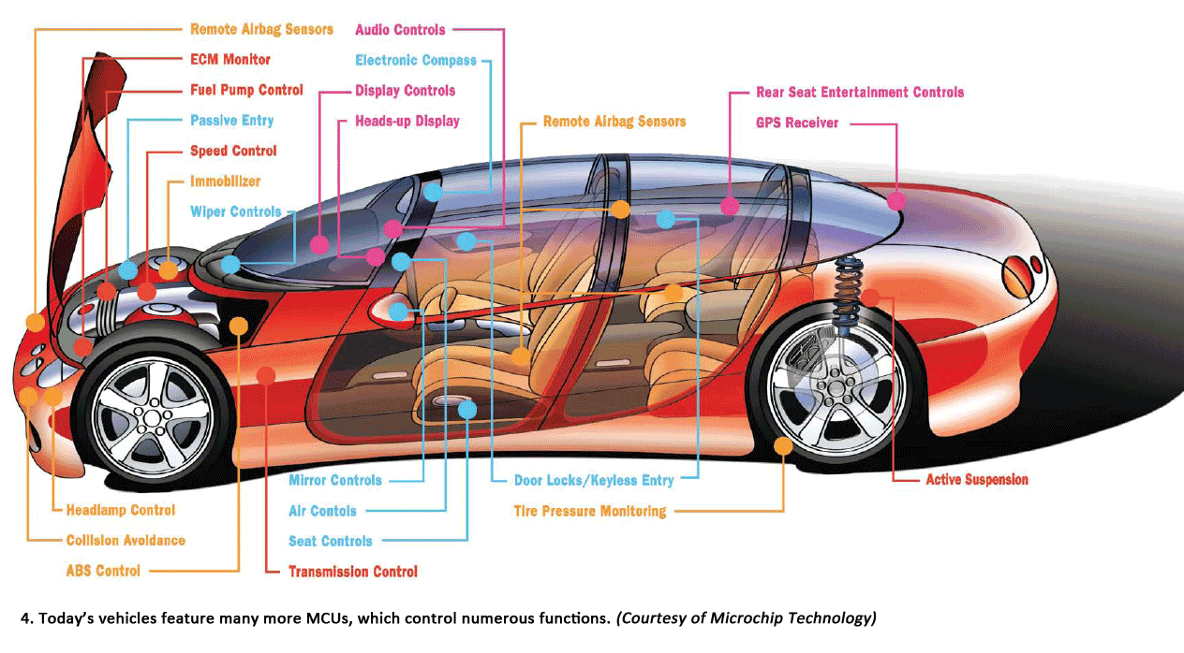
What is a microcontroller ?
Microcontroller (sometimes abbreviated µC, uC or MCU) is a small computer on a single integrated circuit containing a processor core, memory, and programmable input/output peripherals.

Slide 4
Architecture of 8051
Features of 8051
Difference between microprocessor and microcontroller
Pin configuration of 8051
Architecture of 8051
Special function registers

Slide 5
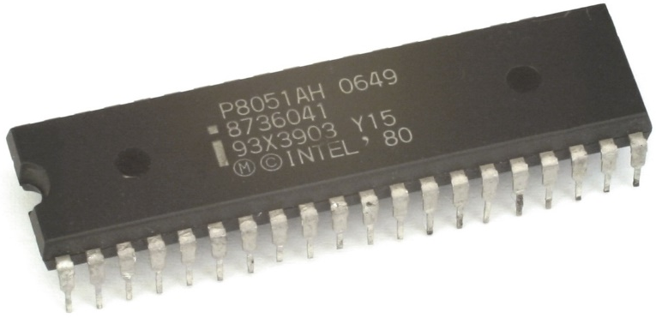
Features of 8051
8 bit CPU with registers A and B
16 bit PC and DPTR(data pointer).
8 bit program status word(PSW)
8 bit Stack Pointer
4K Internal ROM
128bytes Internal RAM
→4 register banks each having 8 registers
→16 bytes, which may be addressed at the bit level.
→80 bytes of general purpose data memory

Slide 6
Features of 8051
32 i/o pins arranged as 4 - 8 bit ports:P0 to P3
Two 16 bit timer/counters:T0 and T1
Full duplex serial data receiver/transmitter
Control registers:TCON,TMOD,SCON,PCON,IP and IE
Two external and Three internal interrupt sources.
Oscillator and Clock Circuits.

Slide 7
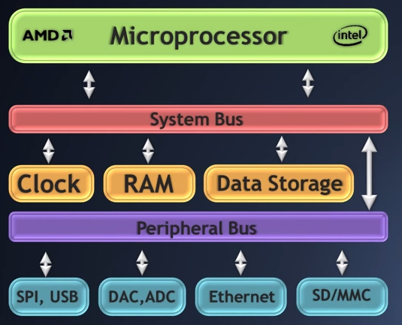
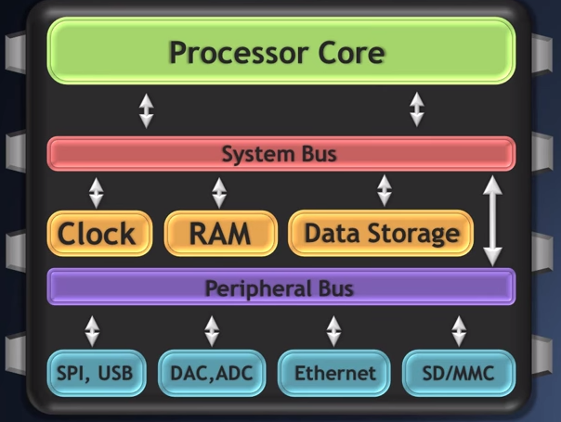
Microprocessors Vs Microcontrollers
Notes:
SPI – Serial Peripheral Interface
USB - Universal Serial Bus
SDC- Secure Digital Card
MMC - Microsoft Management Console – It is a component of Windows 2000 and its successors that provides system administrators and advanced users an interface for configuring and monitoring the system.
Ethernet - a system for connecting a number of computer systems to form a local area network

Slide 8
Microprocessor Vs Microcontroller
Parameters | Microprocessor | Microcontroller
Application | General computing (i.e. Laptops, tablets) | Appliance , specialized devices
Speed | Very fast | Relatively slow
External peripherals | Many | Few
Cost | High | Low
Energy Use | Medium to high | Very low to low
Vendors | Intel, AMD, ARM | Atmel, ST, Texas Instruments, Philips

Slide 9
For examination purpose
Microprocessor | Microcontroller
The architecture uses data lines more than control lines. | The architecture uses control lines more that data lines.
No RAM and ROM on the chip | RAM and ROM along with processor are present
It has single or dual bit instructions | It has multi bit instructions
Access time to memory and I/O devices is high | Access time to memory and I/O devices is less
Less number of pins are multiplexed | More number of pins are multiplexed
Consists of single memory map for data and code | Consists of separate memory map for data and code
High clock frequency | Low clock frequency

Slide 10
For examination purpose
Microprocessor | Microcontroller
External peripheral are to interfaced to enhance functionality | These are application specific and so no need of external peripherals
Can perform all the computation in any field | Can perform only a specific task
Cost is high | Cost is low
I/O communication needs external peripherals | I/O communication ports are inbuilt
Serial communication is not possible | Serial communication ports are inbuilt
Boolean operations cannot be performed directly | Boolean operations can be performed directly

Slide 11
Pin Description of the 8051
P1.0
1
40
Vcc
P1.1
2
39
P0.0(AD0)
P1.2
3
38
P0.1(AD1)
P1.3
4
37
P0.2(AD2)
P1.4
5
36
P0.3(AD3)
P1.5
6
35
P0.4(AD4)
P1.6
7
34
P0.5(AD5)
P1.7
8
33
P0.6(AD6)
RST
9
32
P0.7(AD7)
(RXD)P3.0
10
8051
31
EA/VPP
(TXD)P3.1
11
30
ALE/PROG
(INT0)P3.2
12
29
PSEN
(INT1)P3.3
13
28
P2.7(A15)
(T0)P3.4
14
27
P2.6(A14)
(T1)P3.5
15
26
P2.5(A13)
(WR)P3.6
16
25
P2.4(A12)
(RD)P3.7
17
24
P2.3(A11)
XTAL2
18
23
P2.2(A10)
XTAL1
19
22
P2.1(A9)
GND
20
21
P2.0(A8)

Slide 12
Pins of 8051
Vcc（pin 40）：
Vcc provides supply voltage to the chip.
The voltage source is +5V.
GND（pin 20）：ground
XTAL1 and XTAL2（pins 19,18）：
These 2 pins provide external clock.[1 to 16 MHz]
RST（pin 9）：reset
It is an input pin and is active high（normally low）.
Upon applying a high pulse to RST, the microcontroller will reset and all values in registers will be lost.

Slide 13
Pins of 8051
EA（pin 31）：external access
This pin is connected to GND to indicate the code is stored externally.
For 8051, it is connected to Vcc.
PSEN（pin 29）：program store enable
This is an output pin and is connected to the OE pin of the ROM

Slide 14
Pins of 8051
ALE（pin 30）：address latch enable
It is an output pin and is active high.
8051 port 0 provides both address and data.
The ALE pin is used for de-multiplexing the address and data
I/O port pins
The four ports P0, P1, P2, and P3.
Each port uses 8 pins.
All I/O pins are bi-directional.

Slide 15
Pins of I/O Port
One of the most useful features of the 8051 is that it contains four I/O ports (P0 - P3)
Port 0 （pins 32-39）：P0（P0.0～P0.7）
8-bit R/W - General Purpose I/O
Or acts as a multiplexed low byte address and data bus for external memory design
Port 1 （pins 1-8） ：P1（P1.0～P1.7）
Only 8-bit R/W - General Purpose I/O

Slide 16
Pins of I/O Port
Port 2 （pins 21-28）：P2（P2.0～P2.7）
8-bit R/W - General Purpose I/O
Or high byte of the address bus for external memory design
Port 3 （pins 10-17）：P3（P3.0～P3.7）
General Purpose I/O
if not using any of the internal peripherals (timers) or external interrupts.
Each port can be used as input or output (bi-direction)

Slide 17
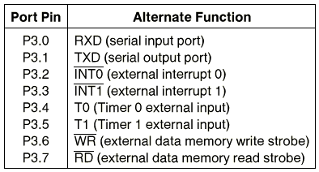
PORT 3

Slide 18
Architecture of 8051

Slide 19
A and B CPU registers
Totally 34 general purpose registers or working registers.
Two of these A and B hold results of many instructions, particularly math and logical operations of 8051 cpu.
The other 32 are in four banks,B0 – B3 of eight registers each.
A(accumulator) is used for addition,subtraction,mul,div,boolean bit manipulation and for data transfers.
But B register can only be used for mul and div operations.

Slide 20
Program Counter & Data Pointer
They are both 16 bit registers.
Each is to hold the address of a byte in memory
PC contains the address of the next instruction to be executed.
DPTR is made up of two 8 bit register DPH and DPL;
DPTR contains the address of internal & external code and data that has to be accessed.

Slide 21
8051 Flag bits and the PSW register

Slide 22
Programming model

Slide 23
Internal RAM structure

Slide 24
Special function registers

Slide 25
P0 (Port 0, Address 80h, Bit-Addressable):
This is input/output port 0.
Each bit of this SFR corresponds to one of the pins on the microcontroller.
For example, bit 0 of port 0 is pin P0.0, bit 7 is pin P0.7.
Writing a value of 1 to a bit of this SFR will send a high level on the corresponding I/O pin whereas a value of 0 will bring it to a low level.

Slide 26
SP (Stack Pointer, Address 81h)
This is the stack pointer of the microcontroller.
This indicates where the next value to be taken from the stack will be read from in Internal RAM.
If you push a value onto the stack, the value will be written to the address of SP + 1.
That is to say, if SP holds the value 07h, a PUSH instruction will push the value onto the stack at address 08h.
This SFR is modified by all instructions which modify the stack, such as PUSH, POP, LCALL, RET, RETI, and whenever interrupts are provoked by the microcontroller.

Slide 27
DPL/DPH (Data Pointer Low/High, Addresses 82h/83h):
The DPL and DPH work together to represent a 16-bit value called the Data Pointer.
The data pointer is used in operations regarding external RAM and some instructions involving code memory.
Since it is an unsigned two-byte integer value, it can represent values from 0000 to FFFF

Slide 28
PCON (Power Control, Addresses 87h):
It is used to control the 8051's power control modes.
Certain operation modes of the 8051 allow the 8051 to go into a type of "sleep" mode which requires much less power.
These modes of operation are controlled through PCON.
Additionally, one of the bits in PCON is used to double the effective baud rate of the 8051's serial port.

Slide 29
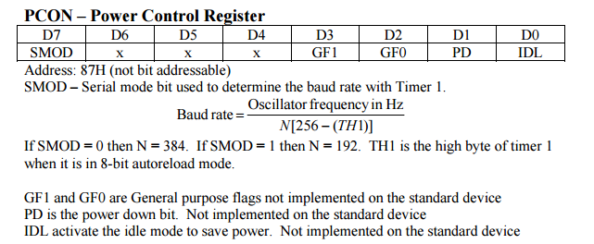
PCON (Power Control, Addresses 87h):

Slide 30
TCON (Timer Control, Addresses 88h, Bit-Addressable):
It is used to configure and modify the way in which the 8051's two timers operate.
This SFR controls whether each of the two timers is running or stopped
It contains a flag to indicate that each timer has overflowed.
Additionally, some non-timer related bits are located in the TCON SFR.
These bits are used to configure the way in which the external interrupts are activated
It contains the external interrupt flags which are set when an external interrupt has occurred.

Slide 31
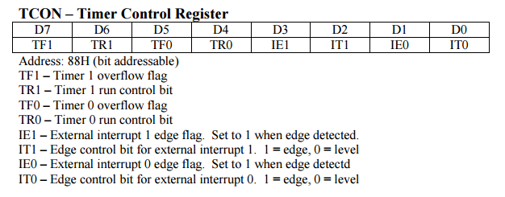
TCON (Timer Control, Addresses 88h, Bit-Addressable):

Slide 32
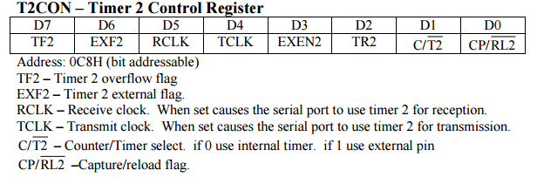
T2CON

Slide 33
TMOD (Timer Mode, Addresses 89h):
It is used to configure the mode of operation of each of the two timers.
Using this the program may configure each timer to be a
16-bit timer,
an 8-bit auto reload timer,
a 13-bit timer,
or two separate timers.
We may configure the timers to only count when an external pin is activated
or
To count "events" that are indicated on an external pin.

Slide 34
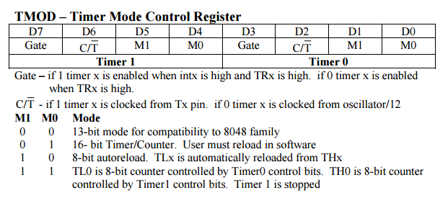
TMOD (Timer Mode, Addresses 89h):

Slide 35
TL0/TH0 (Timer 0 Low/High, Addresses 8Ah/8Ch):
These two represent timer 0.
Their exact behavior depends on how the timer is configured in the TMOD SFR;
However, these timers always count up.
What is configurable is how and when they increment in value.

Slide 36
TL1/TH1 (Timer 1 Low/High, Addresses 8Bh/8Dh):
These two together represent timer 1.
Their exact behavior depends on how the timer is configured in the TMOD SFR;
However, these timers always count up.
What is configurable is how and when they increment in value.

Slide 37
P1 (Port 1, Address 90h, Bit-Addressable):
This is input/output port 1.
Each bit of this SFR corresponds to one of the pins on the microcontroller.
For example, bit 0 of port 1 is pin P1.0, bit 7 is pin P1.7.
Writing a value of 1 to a bit of this SFR will send a high level on the corresponding I/O pin whereas a value of 0 will bring it to a low level.

Slide 38
SCON (Serial Control, Addresses 98h, Bit-Addressable):
It is used to configure the behavior of the 8051's on-board serial port.
This SFR controls the baud rate of the serial port, whether the serial port is activated to receive data,
It contains flags that are set when a byte is successfully sent or received.

Slide 39
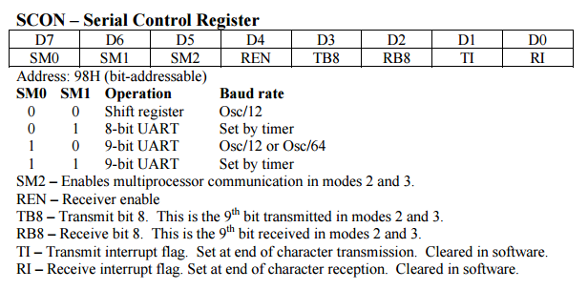
SCON (Serial Control, Addresses 98h, Bit-Addressable):

Slide 40
SBUF (Serial Control, Addresses 99h):
It is used to send and receive data via the on-board serial port.
Any value written to SBUF will be sent out the serial port's TXD pin.
Any value which the 8051 receives via the serial port's RXD pin will be delivered to the user program via SBUF.
In other words, SBUF serves as the output port when written to and as an input port when read from.

Slide 41
P2 (Port 2, Address A0h, Bit-Addressable):
This is input/output port 2.
Each bit of this SFR corresponds to one of the pins on the microcontroller.
For example, bit 0 of port 2 is pin P2.0, bit 7 is pin P2.7.
Writing a value of 1 to a bit of this SFR will send a high level on the corresponding I/O pin whereas a value of 0 will bring it to a low level.

Slide 42
IE (Interrupt Enable, Addresses A8h):
It is used to enable and disable specific interrupts.
The low 7 bits of the SFR are used to enable/disable the specific interrupts,
where as the highest bit is used to enable or disable ALL interrupts.
Thus, if the high bit of IE is 0 all interrupts are disabled regardless of whether an individual interrupt is enabled by setting a lower bit.

Slide 43
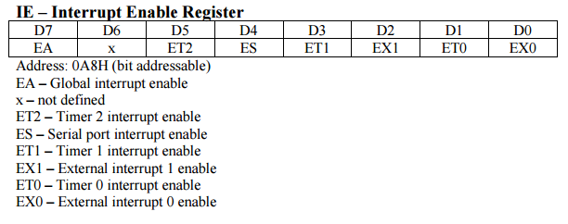
IE (Interrupt Enable, Addresses A8h):

Slide 44
P3 (Port 3, Address B0h, Bit-Addressable):
This is input/output port 3.
Each bit of this SFR corresponds to one of the pins on the microcontroller.
For example, bit 0 of port 3 is pin P3.0, bit 7 is pin P3.7.
Writing a value of 1 to a bit of this SFR will send a high level on the corresponding I/O pin whereas a value of 0 will bring it to a low level.

Slide 45
IP (Interrupt Priority, Addresses B8h, Bit-Addressable):
It is used to specify the relative priority of each interrupt.
On the 8051, an interrupt may either be of low (0) priority or high (1) priority.
An interrupt may only interrupt interrupts of lower priority.
For example, if we configure the 8051 so that all interrupts are of low priority except the serial interrupt, the serial interrupt will always be able to interrupt the system, even if another interrupt is currently executing.
However, if a serial interrupt is executing no other interrupt will be able to interrupt the serial interrupt routine since the serial interrupt routine has the highest priority.

Slide 46
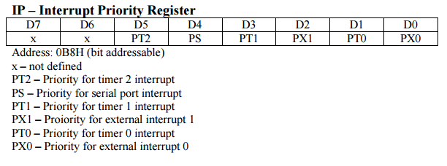
IP (Interrupt Priority, Addresses B8h, Bit-Addressable):

Slide 47
PSW (Program Status Word, Addresses D0h, Bit-Addressable):
The Program Status Word is used to store a number of important bits that are set and cleared by 8051 instructions.
The PSW SFR contains the carry flag, the auxiliary carry flag, the overflow flag, and the parity flag.
Additionally, the PSW register contains the register bank select flags which are used to select which of the "R" register banks are currently selected.

Slide 48
ACC (Accumulator, Addresses E0h, Bit-Addressable):
The Accumulator is one of the most-used SFRs on the 8051 since it is involved in so many instructions.
The Accumulator resides as an SFR at E0h, which means the instruction MOV A,#20h is really the same as MOV E0h,#20h.
However, it is a good idea to use the first method since it only requires two bytes whereas the second option requires three bytes.

Slide 49
B (B Register, Addresses F0h, Bit-Addressable):
The "B" register is used in two instructions: the multiply and divide operations.
The B register is also commonly used by programmers as an auxiliary register to temporarily store values.

Slide 50
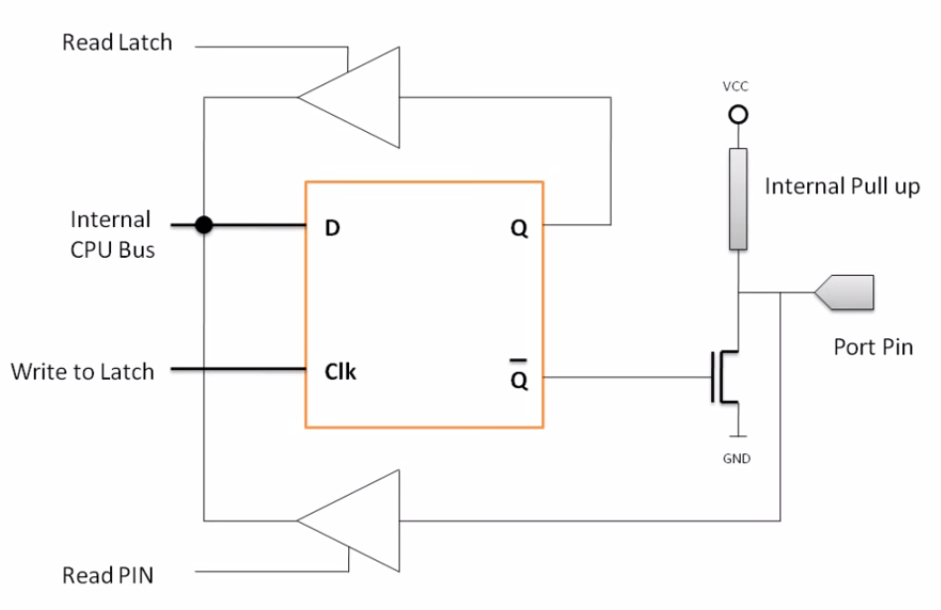
Logic diagram of I/O ports
Tristate Buffer
Output
Buffer
Tristate Buffer

Slide 51
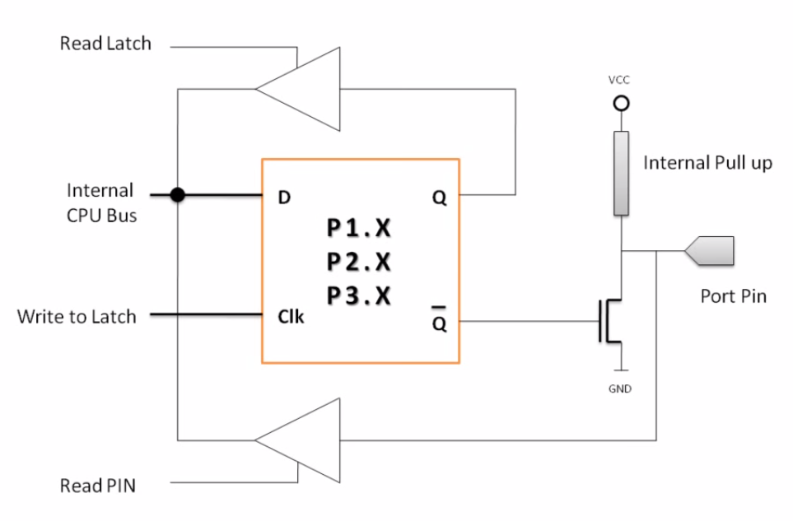
P1,P2 and P3:

Slide 52
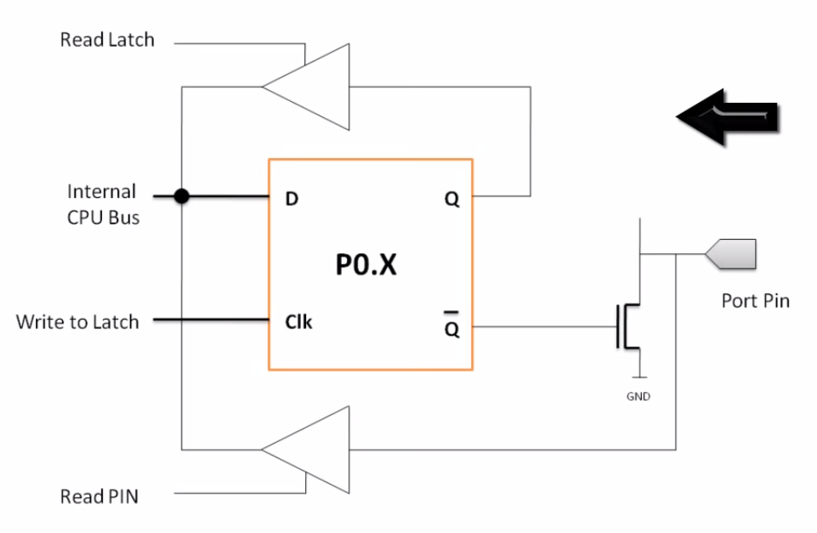
P0:

Slide 53
Writing “1” to Output Pin P1.X
Read latch
Vcc
TB2
Load(L1)
2. output pin is Vcc
1. write a 1 to the pin
1
P1.X pin
Internal CPU bus
D Q
Clk Q
P1.X
0
output 1
Write to latch
M1
TB1
Read pin

Slide 54
Writing “0” to Output Pin P1.X
Read latch
Vcc
TB2
Load(L1)
2. output pin is ground
1. write a 0 to the pin
0
P1.X pin
Internal CPU bus
D Q
Clk Q
P1.X
1
output 0
Write to latch
M1
TB1
Read pin

Slide 55
Reading “High” at Input Pin
Read latch
Vcc
2. MOV A,P1
external pin=High
TB2
write a 1 to the pin MOV P1,#0FFH
Load(L1)
1
1
P1.X pin
Internal CPU bus
D Q
Clk Q
P1.X
0
M1
Write to latch
TB1
Read pin
3. Read pin=1 Read latch=0 Write to latch=1

Slide 56
Reading “Low” at Input Pin
Read latch
Vcc
2. MOV A,P1
external pin=Low
TB2
write a 1 to the pin
MOV P1,#0FFH
Load(L1)
1
0
P1.X pin
Internal CPU bus
D Q
Clk Q
P1.X
0
M1
Write to latch
TB1
Read pin
3. Read pin=1 Read latch=0 Write to latch=1

Slide 57
To be continued…

Slide 58
Instruction Set
An instruction is an order or command given to a processor by a computer program. All commands are known as instruction set and set of instructions is known as program.
8051 have in total 111 instructions, i.e. 111 different words available for program writing.

Slide 59
Instruction Format
Where first part describes WHAT should be done, while other explains HOW to do it.
The latter part can be a data (binary number) or the address at which the data is stored.
Depending upon the number of bytes required to represent 1 instruction completely.

Slide 60
Types Of Instructions
Instructions are divided into 3 types;
One/single byte instruction.
Two/double byte instruction.
Three/triple byte instruction.

Slide 61
One/single byte instructions
If operand is not given in the instruction
or
there is no digits present with instruction, the instructions can be completely represented in one byte opcode.
OPCODE 8 bit

Slide 62
Two/double byte instruction
If 8 bit number is given as operand in the instruction, the such instructions can be completed represented in two bytes.
First byte OPCODE
Second byte 8 bit data or I/O port

Slide 63
Three/triple byte instruction
If 16 bit number is given as operand in the instructions than such instructions can be completely represented in three bytes 16 bit number specified may be data or address.

Slide 64
Types Of Instructions
Data transfer instructions.
Arithmetic instructions.
Logical instructions.
Logical instructions with bits.
Branch instructions.

